Slide 1

Implementing SNAP Volunteer Programs
Presented by:
Hope Pavich/Ryan Spangler
Care For Friends/Heartland Alliance
Notes:
Note: Reference to Medicaid removed. New work requirements for Medicaid do not take effect until 2027 at the earliest.

Slide 2
Agenda
Introduction
Background and Context
Program Objectives
Partner Actions and Opportunities
Volunteer Program Implementation Framework
Training and Support Strategy
Empowering Your Volunteers
Building Your Support Network
Measuring Success
Closing and Q&A

Slide 3

Introduction
  Purpose: Empower Community Based Organizations (CBO) with the tools and knowledge to successfully implement Volunteer Opportunities for SNAP & Medicaid Retention.
  This training will include:
      Program Guidelines
      Outreach Strategies
      Volunteer Recruiting
      Compliance and Reporting
Notes:
The goal here is to give community-based organizations (CBOs) everything they need to confidently offer volunteer opportunities to help people maintain SNAP and Medicaid benefits.
This training will walk through:
the key program guidelines,
share smart outreach strategies,
offer tips for recruiting volunteers, and
cover how to stay on top of compliance and reporting.
It’s all about setting CBOs up for success from day one!

Slide 4
Background and Context
  Overview of SNAP Changes and Work Requirements*
      Applies to ABAWDs (Able Bodied Adults Without Dependents) ages 18 to 64 (expanded from 18-54 under 2025 OBBBA law).
      Must work or participate in approved activities at least 20 hours/week (80 hours per month). Activities can include paid work, approved job training or education or verified volunteer/community service.
NOTE: To continue receiving SNAP benefits beyond the 3-month limit, ABAWDs must either meet the work requirement each month or qualify for an exemption.
*IDHS: PM 03-25-00: SNAP Work Requirement
Notes:
Exemptions for ABAWD:
Individuals who are pregnant; medically unable to work
Dependents:
Children under 14
Children under 24 if full-time students
Caring for a disabled person
Elderly living with you and rely on your financial support
Revisions to exemptions (who are no longer eligible) at State Level:
Elderly ages 60-64
Homeless individuals, veterans, people aged out of foster care (>18 years old)
Immigrants, Refugees, Asylum Seekers, parolees < 1year
T Visa or T Non-Immigrant Status (Temporary visa for victims of a severe form of human trafficking or torture, and are assisting with law enforcement investigation or prosecution)

Slide 5
Program Objectives
      Care For Friends is committed to building a meaningful volunteer program that empowers individuals to meet SNAP work requirements while actively contributing to the well-being of our community. This initiative will:
      Increase public awareness of available volunteer programs
      Equip applicants with valuable skills through education or volunteer-driven initiatives
      Strengthen collaboration with CBOs by creating meaningful volunteer opportunities that support shared goals and enhance community impact
      Ensure continued access to essential SNAP benefits
Notes:
Care For Friends has posted a benefits retention toolkit that does more than just help people meet SNAP work requirements—it’s designed to make a real difference in the community.
The idea is to raise awareness about volunteer opportunities, help folks build useful skills through hands-on experience or training, and work closely with community-based organizations to create impactful roles.
Ultimately, it’s about making sure people stay connected to the benefits they need

Slide 6
Key Milestones
  Available Now: Updated SNAP Information published on GCFD website: Food Depository SNAP One-Pager
  February 2026: Volunteer or work requirements implementation begins and first reporting period starts
  May 1, 2026: Beneficiaries who do not meet the new requirements face loss of coverage.
REMINDER: Failure to submit three reports—whether consecutive or not—will result in the cancellation of benefits and a three-year restriction on receiving benefits.
Notes:
Exemptions for ABAWD:
Individuals who are pregnant
Dependents:
Children under 14
Children under 24 if full-time students
Caring for a disabled person
Elderly living with you and rely on your financial support
Revisions to exemptions (who are no longer eligible) at State Level:
Elderly ages 60-64
Homeless individuals, veterans, people aged out of foster care (>18 years old)
Immigrants, Refugees, Asylum Seekers, parolees < 1year
T Visa or T Non-Immigrant Status (Temporary visa for victims of a severe form of human trafficking or torture, and are assisting with law enforcement investigation or prosecution)
Medicaid Implementation Timeline:
- The Secretary of Health and Human Services (HHS) must issue guidance to states by June 1, 2026.
- States are required to implement the work requirements by December 31, 2026, though they can start earlier via waivers.
- Extensions up to 2028 may be granted for states showing good-faith efforts.

Slide 7
Work Requirement Exemptions for ABAWD
Under 18 or over 65 years old
Medically certified as physically or mentally unfit for employment
Primary caregivers of a dependent child under 14 or incapacitated person
Pregnant individuals
Full time students under 24
Exempt from general SNAP work requirements (e.g., already working 30+ hours/week or $935 gross monthly income, in school half-time, caring for a child under 6, or in treatment programs)
American Indians and Alaska Natives
People in substance use treatment programs
Notes:
Exemptions for ABAWD:
Individuals who are pregnant
Dependents:
Children under 14
Children under 24 if full-time students
Caring for a disabled person
Elderly living with you and rely on your financial support
Revisions to exemptions (who are no longer eligible) at State Level:
Elderly ages 60-64
Homeless individuals, veterans, people aged out of foster care (>18 years old)
Immigrants, Refugees, Asylum Seekers, Parolees < 1year
T Visa or T Non-Immigrant Status (Temporary visa for victims of a severe form of human trafficking or torture, and are assisting with law enforcement investigation or prosecution)

Slide 8
Exemptions No Longer Applicable
Elderly ages 60-64
Veterans
People experiencing homelessness for 12 months
Former foster youth up to age 24
Immigrants, Refugees, Asylum Seekers and Parolees (< 1year)
T Visa or T Non-Immigrant Status (Temporary visa for victims of a severe form of human trafficking or torture, and are assisting with law enforcement investigation or prosecution)
https://www.dhs.state.il.us/page.aspx?item=174187
Notes:
Exemptions for ABAWD:
Individuals who are pregnant
Dependents:
Children under 14
Children under 24 if full-time students
Caring for a disabled person
Elderly living with you and rely on your financial support
Revisions to exemptions (who are no longer eligible) at State Level:
Elderly ages 60-64
Homeless individuals, veterans, people aged out of foster care (>18 years old)
Immigrants, Refugees, Asylum Seekers, Parolees < 1year
T Visa or T Non-Immigrant Status (Temporary visa for victims of a severe form of human trafficking or torture, and are assisting with law enforcement investigation or prosecution)

Slide 9
Exemptions Forms
Always seek out possible exemptions first.
IDHS Form IL444-2341 - SNAP Work Request for Exemption
Submit exemption form and any documentation proving exemption.
State on forms that the exemption status starts in February 2026.
Notes:
https://www.dhs.state.il.us/onenetlibrary/12/documents/Forms/442341-202406.pdf

Slide 10
Reporting Work, Training, or Volunteer Hours
For SNAP assistance, visit ABE.Illinois.gov or call 1-833-2-FIND-HELP
Step 1: Download the IL444-2610 form from Illinois DHS Forms Library
Step 2: Complete the top portion of the form:
Client Name
FCRC (Family Community Resource Center Name)
Case Number
Work and Training (Volunteer) Activity type/description
Date of the Activity
Start and Finish Times
Client Signature and Date
Step 3: Organization Verification:
Name of Organization
Authorized Signature and Date
Authorized Contact Name and Contact Information
Step 4: Submit the Form*:
Upload via ABE Manage My Case (online)
Drop off at local FCRC IDHS Office Locator
Mail or Fax to your local FCRC office
*NOTE: Use a separate a form for each organization.

Slide 11
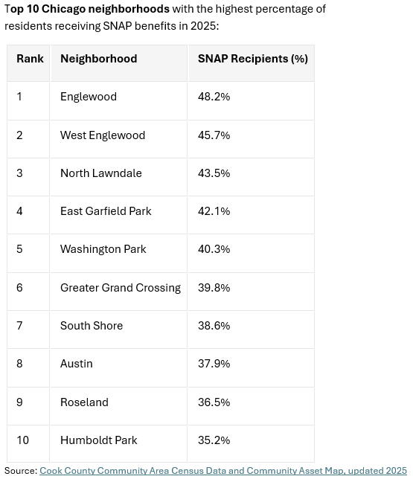
Partner Actions and Opportunities
Inform & Empower: Update community on new SNAP requirements.
Expand Outreach: Team up with partners in underserved areas to help more people get the services they need.
Train & Recognize: Equip volunteers with skills that support partners and prepare them for future education or employment.
Assist with Technology: Help volunteers use online platforms for timely service reporting and to avoid benefit disruptions.
Simplify Processes: Provide clear guidance to make service reporting and IDHS verification process.
Notes:
Care For Friends wants to make sure volunteers are informed, supported, and set up for success.
That means keeping them up to date on SNAP rules, teaming up with GCFD partners to reach more people in underserved areas, and offering training that builds skills for future jobs or education.
They’re also helping volunteers navigate online tools so they can report their service on time and avoid any hiccups with benefits.
And to make everything smoother, they’re simplifying the reporting and verification process so it’s easier to follow.

Slide 12
Care For Friends
SNAP Benefits Retention Plan
Raise Awareness of changes!
Always seek out possible exemptions.
  IDHS Form 2341 - SNAP Work Request for Exemption
  Legal Aid Chicago is expanding capacity to assist individuals, whose DHS benefits are threatened or terminated.
At your site:
  Share all volunteer opportunities.
  Think “outside of the box” for additional opportunities.
  Research and create resource binder of volunteer opportunities with local CBOs. (This could be a volunteer!)
Keep your typical process of documenting hours.
Submit via ABE.Illinois.gov portal. (This could be a volunteer!)
Notes:
Here’s how Care For Friends is making it easier for volunteers to get involved and stay informed:
They’re keeping current participants in the loop with updates to boost engagement, and spreading the word through websites, flyers, social media, and partner networks.
Signing up is simple thanks to a user-friendly portal where volunteers can browse roles and register quickly.
Staff and volunteers also get access to training materials and tools to help with accurate reporting and support.
Plus, they’re teaming up with local schools, nonprofits, and businesses to grow their reach—and guiding volunteers toward other helpful programs like WIC and workforce training to make sure they’re getting all the support they need.
------------------------------------------------------------------------------------------------------------
A strategy is a high-level plan designed to achieve a specific goal or set of goals. It’s about making choices and prioritizing actions to gain an advantage or solve a problem.
Purpose: To define direction and focus efforts.
Nature: Goal-oriented and adaptive.
A framework is a structured approach or system that provides a foundation for decision-making, planning, or execution. It’s like a toolkit or blueprint that helps guide how something should be done.
Purpose: To organize thinking, processes, or actions.
Nature: Often conceptual or procedural.

Slide 13
Volunteer Program Implementation Framework
Engage Existing Participants: Share updates with current volunteers and guests to build awareness and involvement.
Get The Word Out: Use your website, flyers, social media, and partner networks to promote the program.
Streamline Sign-Up Process: Offer an easy-to-use portal for volunteers to explore roles and register quickly.
Prepare Your Resources: Provide staff and volunteers with training materials and tools for accurate reporting and participant support.
Build Local Partnerships: Collaborate with schools, nonprofits, and businesses to expand reach and visibility.
Explore Other Services: Guide volunteers to additional programs like WIC, workforce training, and other benefits.
Notes:
Here’s how Care For Friends is making it easier for volunteers to get involved and stay informed:
They’re keeping current participants in the loop with updates to boost engagement, and spreading the word through websites, flyers, social media, and partner networks.
Signing up is simple thanks to a user-friendly portal where volunteers can browse roles and register quickly.
Staff and volunteers also get access to training materials and tools to help with accurate reporting and support.
Plus, they’re teaming up with local schools, nonprofits, and businesses to grow their reach—and guiding volunteers toward other helpful programs like WIC and workforce training to make sure they’re getting all the support they need.
------------------------------------------------------------------------------------------------------------
A strategy is a high-level plan designed to achieve a specific goal or set of goals. It’s about making choices and prioritizing actions to gain an advantage or solve a problem.
Purpose: To define direction and focus efforts.
Nature: Goal-oriented and adaptive.
A framework is a structured approach or system that provides a foundation for decision-making, planning, or execution. It’s like a toolkit or blueprint that helps guide how something should be done.
Purpose: To organize thinking, processes, or actions.
Nature: Often conceptual or procedural.

Slide 14
Examples of Volunteer Roles in Action
Client Facing | Behind-the-Scenes | Delivery & Outreach | Community-Based
Greeter at Soup Kitchen | Food Sorter/Stocker | Food/Grocery/Meal Delivery | Neighborhood Clean-Up
Pantry Shopper Assistant | Warehousing | SNAP Resource Navigation | Shelter Support
Registration Helper (In-Person/Virtual) | Kitchen Clean-up Crew | Wellness Check-In (In-Person/Virtual) | Community Garden Maintenance
Multilingual Support | Letter Writing (Virtual) | Event Support | Library Help
Tutoring (In-Person/Virtual) |  |  | Youth Mentorship

Slide 15
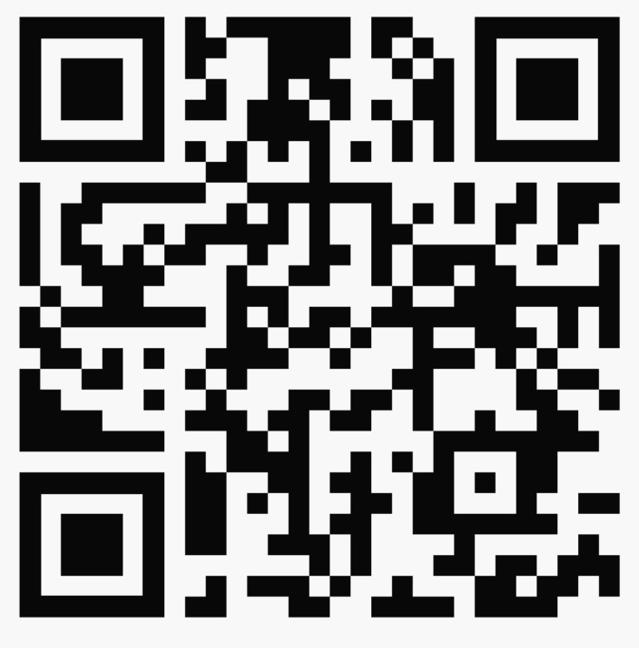
Expanding Your Community Network
      Engage with community-based organizations (CBOs) in your neighborhoods to explore all possible volunteer opportunities:
      Identify key organizations
      Reach out and connect
      Unite efforts
      Simplify sign-up process
      Stay connected
Care For Friends Sign-Up QR Code
Notes:
1. Identify Key Organizations
-Compile a list of nonprofits, faith groups, schools, and local initiatives in each neighborhood.
-Understand their missions and current volunteer needs.
2. Reach out and connect
-Send personalized outreach emails or letters introducing Care For Friends and share purpose of the program
-Attend local events or community meetings to build relationships in person.
3. Unite efforts
-Highlight how collaboration can benefit both organizations (e.g., shared resources, referrals).
-Be clear about the types of volunteer opportunities available.
-Offer flexible roles and schedules to accommodate different organizations.
4. Simplify sign-up process
-Helping volunteers find the right opportunities i.e. zip-code search, Neighborhood search, skill-based search, virtual, on-site or client facing
-Provide easy sign-up options for volunteers, i.e. Use of QR Code on flyers, posters, newsletters, etc.
-Work through technology roadblocks
5. Stay connected
-Share updates, success stories, and impact reports.
-Invite partners to co-host events or participate in joint initiatives.

Slide 16
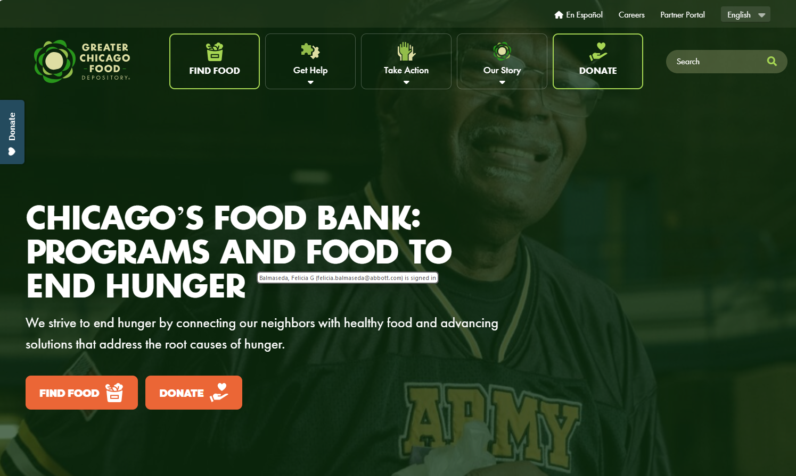
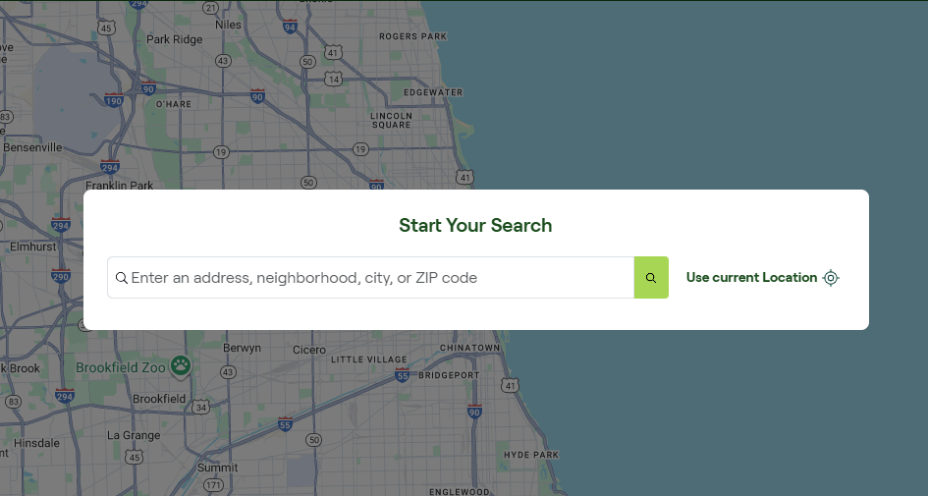
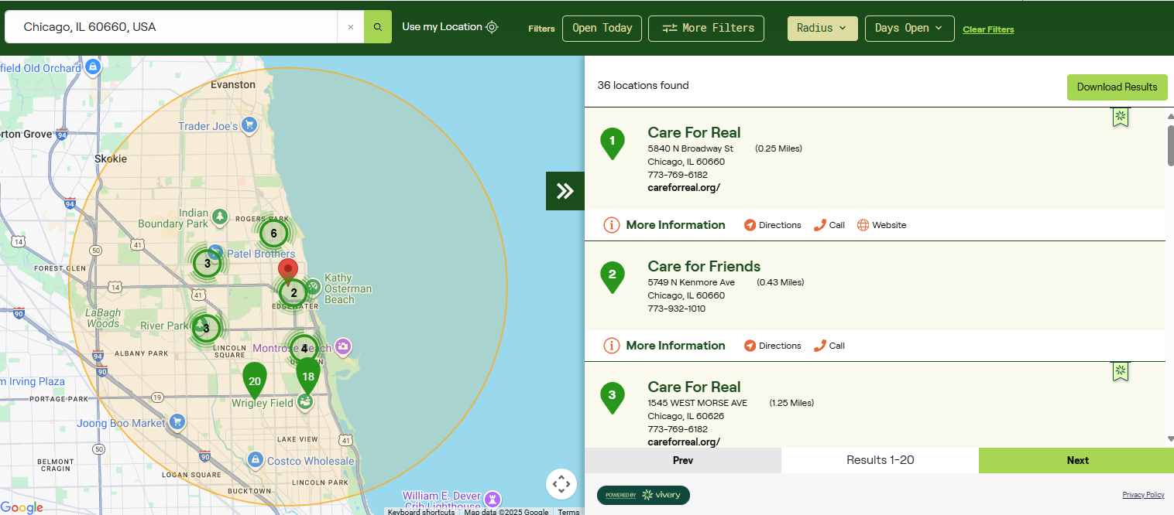
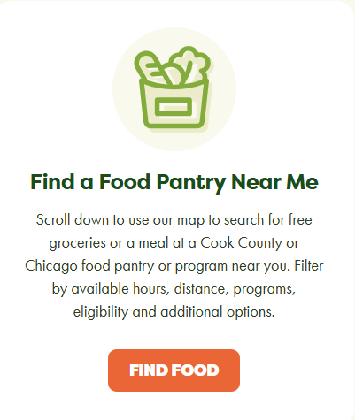
Finding Volunteer Partners through GCFD
1
3
STEP 3: Enter a zip code to search for partners in a specific neighborhood.
STEP 1: Select “FIND FOOD” from the Food Depository in Chicago | Greater Chicago Food Depository website
4
2
STEP 2: Scroll down to “Find a Food Pantry Near Me” and click “FIND FOOD”
STEP 4: Browse the list to locate volunteer opportunities from participating partners.

Slide 17
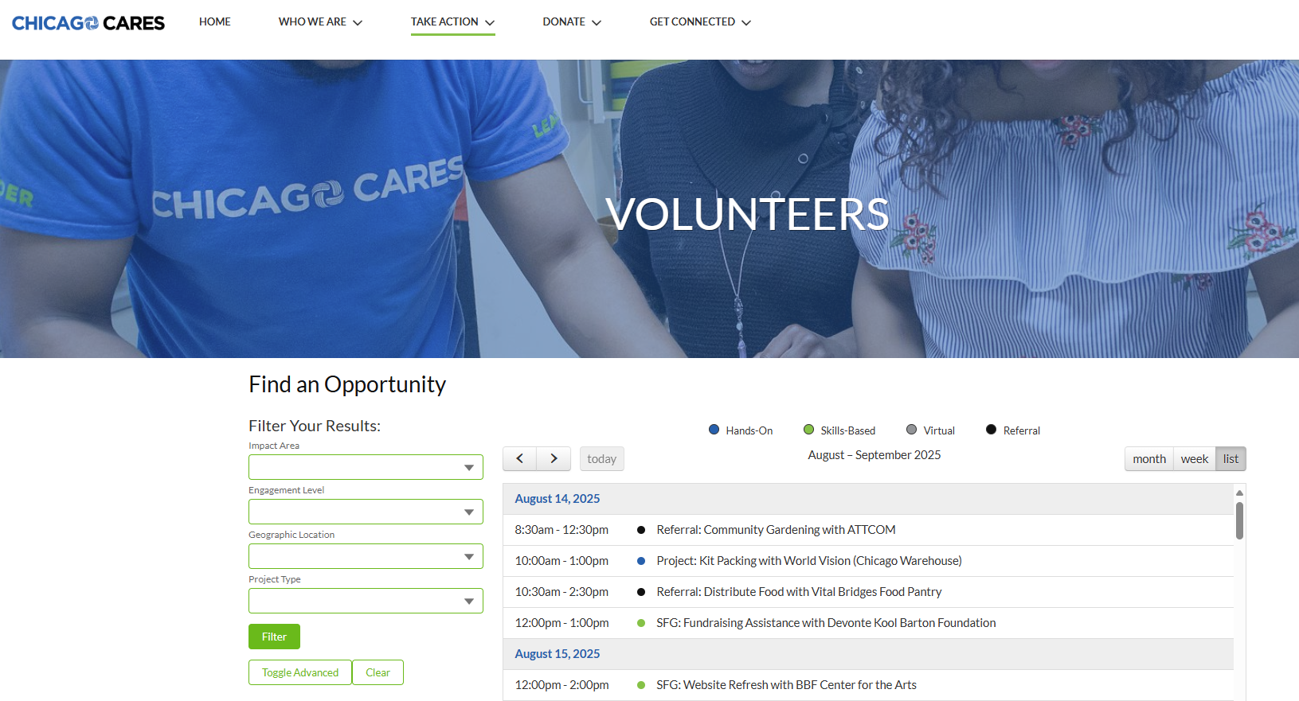
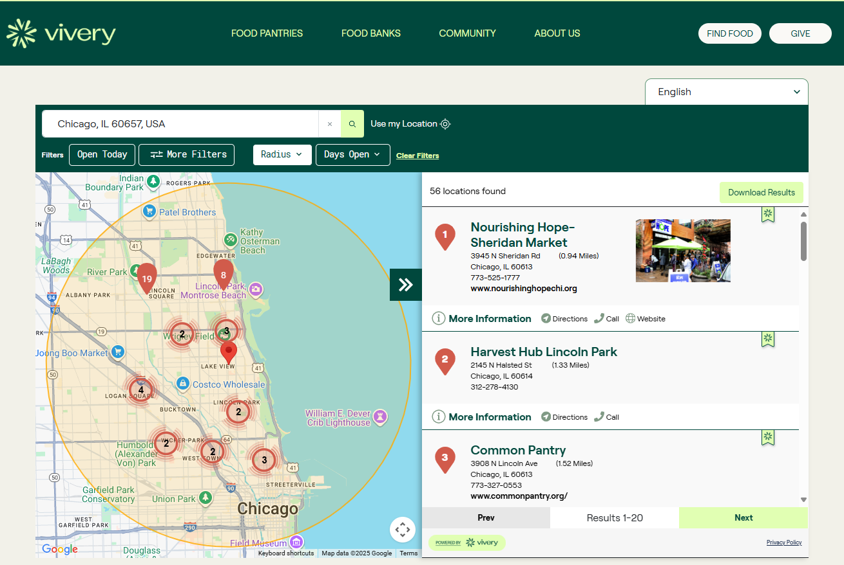
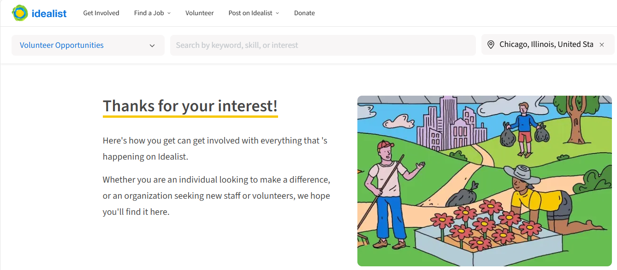

Finding Volunteer Partners
Identify areas of interest based on location, cause, skills and availability.
Contact partners directly or indirectly through online platform, such as Idealist.org (previously VolunteerMatch.org ), Vivery, Chicago Cares, United Way, etc.
Check local community boards, church newsletters, and social media platforms like Facebook, Instagram and Nextdoor.
Register and apply.
www.chicagocares.org
United Way of Metro Chicago
www.Idealist.org
www.vivery.org

Slide 18
Training and Support Strategy
Support Strategy
Provide a Handbook
Share a clear guide with program details and FAQs.
Use a Buddy System
Pair new volunteers with experienced ones for smoother onboarding.
Offer Flexible Training
Provide virtual, in-person, and on-demand options to fit different needs.
Give Feedback & Recognition
Check in regularly, offer support, and celebrate volunteer contributions.
Leverage Technology
Implement software to manage sign-ups, schedules, and communication.
  Training Strategy
Start with Orientation
Introduce volunteers to your mission, values, and expectations to build commitment.
Train for Specific Roles
Teach volunteers the tasks they’ll be doing, like greeting or registering guests.
Provide Tech Training
Show how to use online tools for logging hours and accessing resources.
Promote Inclusive Engagement
Prepare volunteers to interact respectfully with people from diverse backgrounds.
Notes:
The next few slides will walk through the execution-related aspects of the program:
Here’s how Care For Friends is approaching volunteer training:
It all starts with an orientation that introduces volunteers to the mission, values, and what’s expected of them.
Then, they get hands-on training for the specific roles they’ll be taking on, whether it’s greeting guests or helping with food services.
We’ll provide tech support to make sure everyone knows how to download the form and assist with the submission process. Reporting is not an on-line process.
And just as important, volunteers will be coached on how to engage with our guests, creating a welcoming and inclusive environment for everyone.
Here’s how Care For Friends plans to support volunteers every step of the way:
They’ll start by sharing a handy guide with all the key program info and FAQs, so everyone knows what to expect.
New volunteers will be paired with seasoned ones to make onboarding feel more comfortable and connected.
Training will be flexible—whether you prefer virtual, in-person, or on-demand options, there’s something to fit your schedule. Regular check-ins and shout-outs will keep volunteers motivated and appreciated.
And to keep everything running smoothly, they’re using software to manage sign-ups, schedules, and communication.

Slide 19
Empowering Your Volunteers
        Community Service: Work with non-profit or community organizations for 20 hours per week (80 hours per month) to satisfy SNAP work requirements
        Support Services: Assist with food distribution, health outreach or administrative tasks at local partners or foodbanks
        Reporting: Assist volunteers with mail of fax reporting of hours to ensure compliance with benefit rules and avoid disruptions
        SNAP Employment Training: Participate in approved programs, i.e. basic education, vocational training or work experience
Notes:
Here’s how volunteers can stay on track with SNAP requirements while making a real impact:
By committing to 20 hours a week—or 80 hours a month—of community service with local nonprofits or organizations, they meet the work requirements and help their neighbors at the same time.
That could mean lending a hand with food distribution, health outreach, or even behind-the-scenes admin work at food banks and partner sites.
Volunteers also get help with logging their hours via mail or fax, to make sure everything’s reported properly, and benefits stay uninterrupted.
And for those looking to build skills, there are approved training programs available—like basic education, vocational courses, or hands-on work experience.

Slide 20
Building Your Support Network
      State and Local Agencies: Understand SNAP programs requirements and ensure rules are followed, i.e. IL Department of Human Services, IL Department of Healthcare and Family Services,
      Local Nonprofits: Expand outreach and improve access to resources in underserved communities.
      Health Partners: Support volunteer involvement in healthcare setting.
      Staff: Manage volunteer recruitment, training and service delivery.
      Volunteers and Guests: Provide valuable input for service improvement.
Notes:
Here’s how Care For Friends builds a strong support network to keep everything running smoothly:
Make sure everyone’s following the rules for SNAP as published by State & Local Agencies
Partner with Local nonprofits to help broaden outreach and connect more people in underserved areas with vital resources.
Reach out to Health partners for opportunities in a medical setting.
Support staff members with day-to-day activities, like bringing in volunteers, training them and provide oversight so the program runs smoothly.
Provide feedback to your volunteers and guests; Your feedback is essential for making services better and more responsive to community needs.

Slide 21
Measuring Your Success
      Volunteer Engagement & Retention:
        Number of active volunteers over time
        Volunteer retention rate (Monthly/Annual)
        Ratio of new vs. returning volunteers
      Outreach & Access Expansion:
        Number of individuals reached through volunteer-led outreach
        Geographic coverage of outreach efforts
      Impact & Outcomes
        Number of individuals enrolled who successfully maintain eligibility for SNAP benefits.
        Feedback from beneficiaries on service improvements
        Volunteer contributions translated into cost savings or expended program capacity
Notes:
Volunteer Engagement & Retention We’re looking at how many volunteers stay active over time, how often they come back month after month or year after year, and how many are new versus returning. It helps us understand what’s keeping people involved and where we can improve.
Outreach & Access Expansion We’re also measuring how many people are being reached through volunteer-led efforts and how far those efforts are spreading across different neighborhoods. It’s all about making sure we’re growing in the right direction and reaching those who need us most.
Impact and Outcomes We’re keeping track of how many people who enroll are able to stay eligible for their SNAP benefits—that’s a big sign we’re doing something right. We’re also listening closely to feedback from those we serve to understand what’s working and where we can improve. And when volunteers step in, their contributions help stretch our resources further, whether that means saving costs or expanding what the program can offer.

Slide 22
Closing and Q&A
      Recap of goals and impact
      Questions & Feedback
      Thank you!

Slide 23
Thank you
Care For Friends
Hope Pavich
Executive Director
530 W. Fullerton Avenue
Chicago, IL 60600
773.932.1010

Slide 24
Appendix

Slide 25
Volunteer Types
Volunteer Types | Description
Hands-On | Volunteers who engage in physical, in-person activities that directly support the agency, such as, food pantries, animal shelters, community gardening, environmental clean-up, etc.
Virtual | Remote volunteers who contribute their time and skills online, such as online tutoring, social media support, legal aid, etc.
Skilled | Volunteers who apply professional expertise, such as, accounting, IT support, counseling, etc.
Community Based | Volunteers who build connections and offer support such as, mentorship, senior companionship, event support, etc.

Slide 26
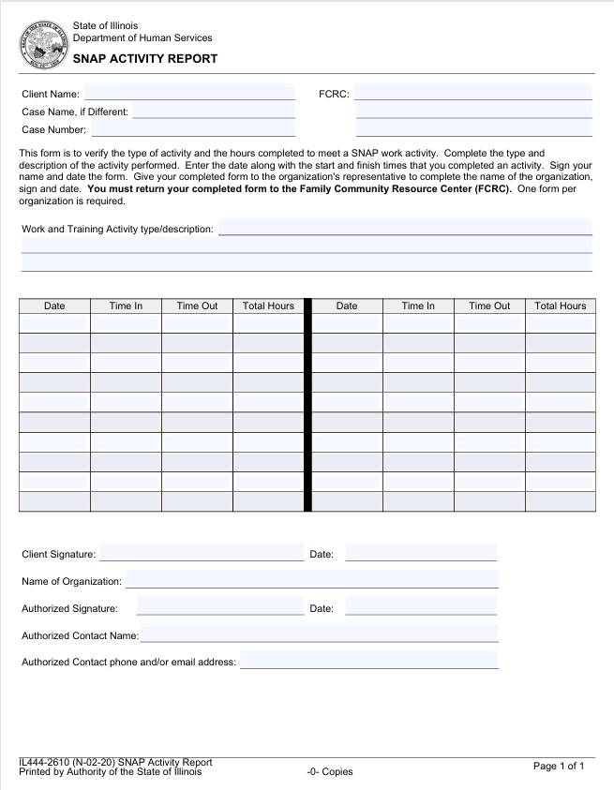
IDHS Form IL444-2610

Slide 27

Sample Care For Friends Flyer
Care For Friends Volunteer Program
Are you looking to fulfill your SNAP volunteer requirements?
Join our volunteer program to support your community and fulfill SNAP volunteer requirements.
We provide meaningful opportunities and proper documentation to help you meet IDHS guidelines.
We provide guidance and support to ensure your hours are properly documented and verified.
Get started today and be part of a program that makes a real impact in your community!
Contact us at info@careforfriends.org, with locations in locations in Lincoln Park, Edgewater and South Loop | 773.932.1010

Slide 28
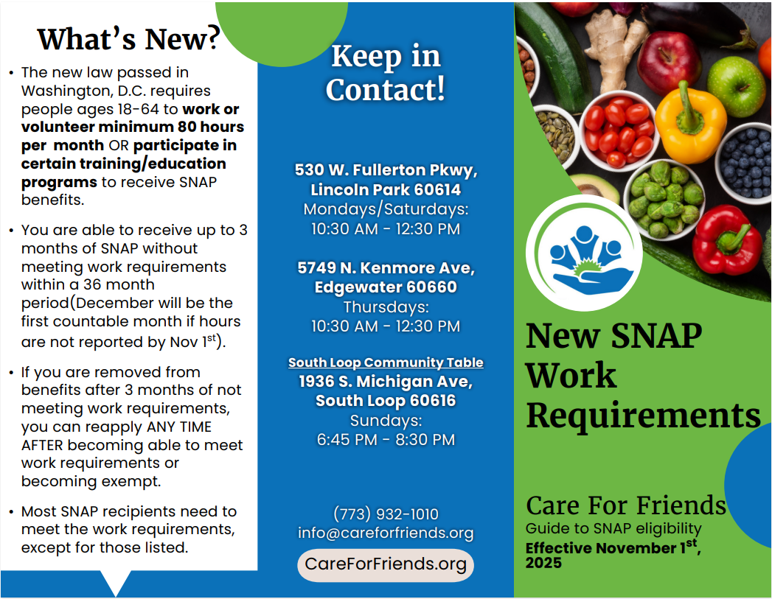
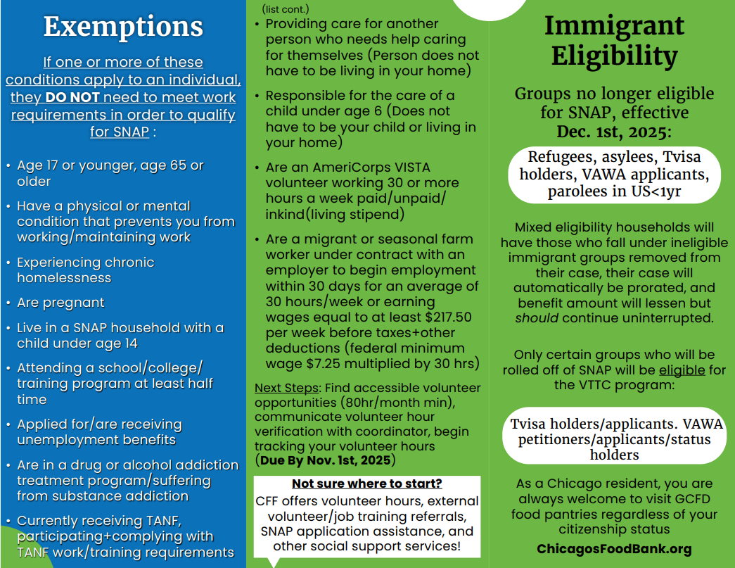
Care For Friends Tri-Fold Pamphlet

Slide 29
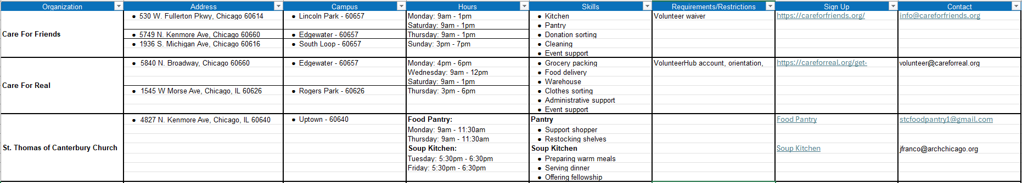
Sample Collection of CBOs

